Slide 1
Smart Power Management
prepared by –
Tanya Ranjan
khushraj jain
(st. joseph’s college)

Slide 2
FLOW OF PRESENTATION
Introduction
Specifications
About model
Motivation Behind Power Management
Approaches To Power Management
Applications

Slide 3
INTRODUCTION
Power Management: A set of H/W and S/W
techniques used to minimize the power
consumption of a device while meeting its
performance requirements.

Slide 4
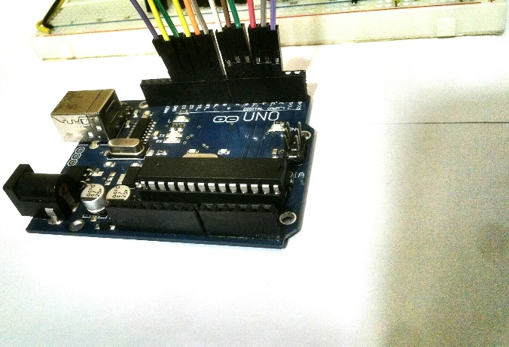
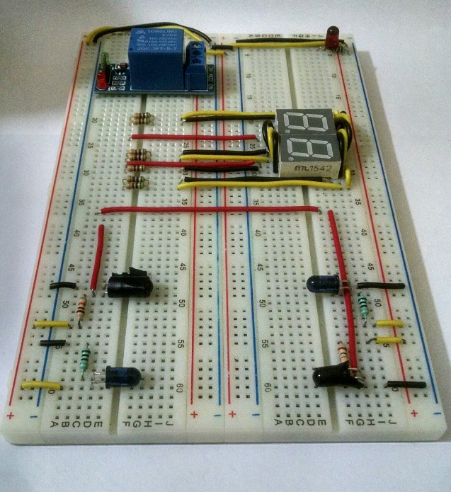
specifications
Arduino uno
LED
Transistor
Lamp
IR LED’s
Relay
IR Receivers
7-segement displays
Ardunio compiler
Bread Board

Slide 5
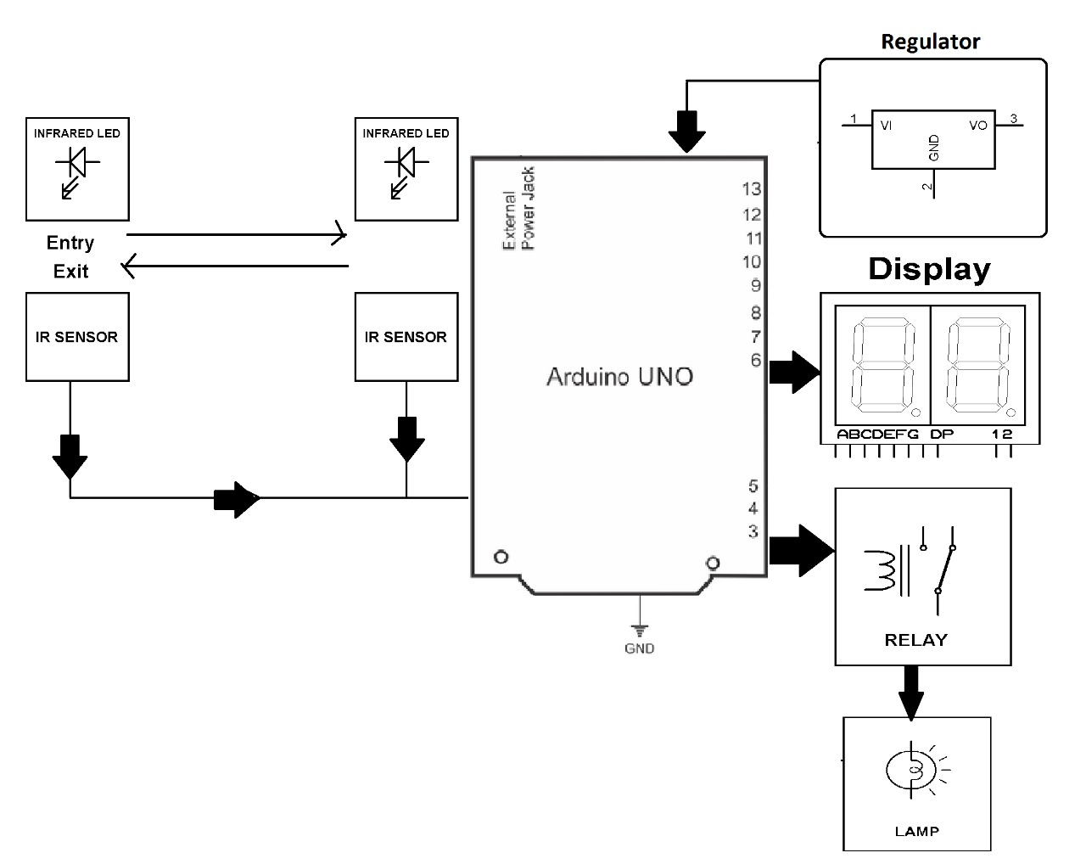
Circuit design

Slide 6
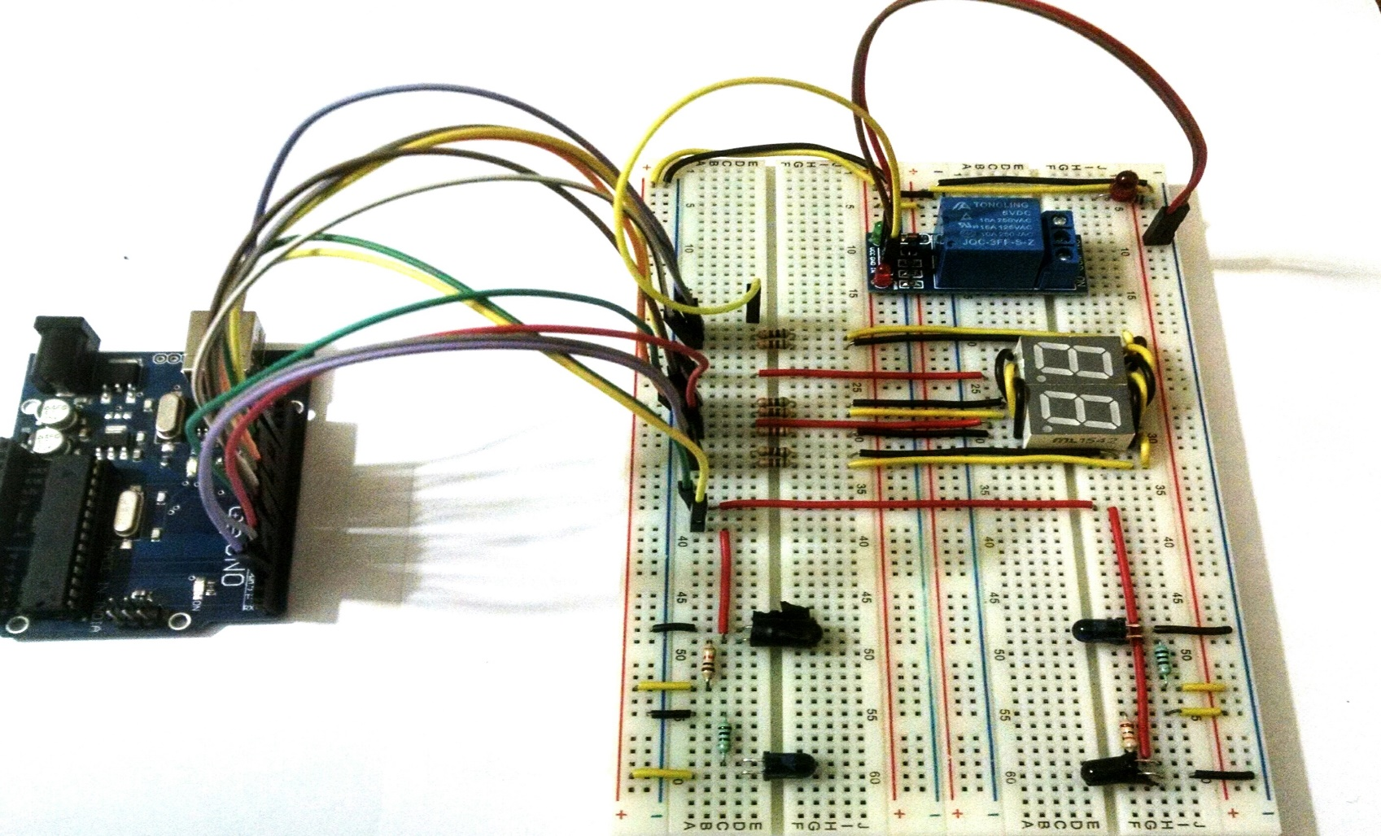
Model Design

Slide 7
About model
The system is designed for optimum energy usage by monitoring the number of people present in the room. The electric loads are switched on as soon as someone is present in the room and switches of on detecting no presence.
The system uses InfraRed Sensor pairs in order to fulfil this purpose and thus saves a large amount of energy. Each pair consists of 2 sensor pairs placed at a certain distance from one another in the opposite direction. The IR transmitter is used to transmit IR rays straight to the receiver which receives the input and feeds this to an arduino
As soon as a person enters into the room, it is detected by the IR sensor module and this info is fed to the ardino. The microcontroller process this input received and switches on the load. At this time the system also counts the number of people present and increments a counter on each arrival, this count is displayed on a 7 segment display. As soon as the last person exits the room, the sensor detects no presence and hence switches off the load/lamp. A small lamp is used to demonstrate as a load.

Slide 8
Motivation Behind Power Management
To enhance battery life
reduces operating cost for energy
Reduces the impact on the environment
Reduces energy consumption
Improves economy(saves money)
Comfortable to use

Slide 9
Approaches To Power Management
Cut the power supply in a room automatically when not required.
Count the number of people (or say objects) present in the room.

Slide 10
Applications
Setup can be used in library , classroom and other public lecture halls and conference rooms.
In shopping malls to control the power supply and for counting of people (count one people at a time)

